Slide 1
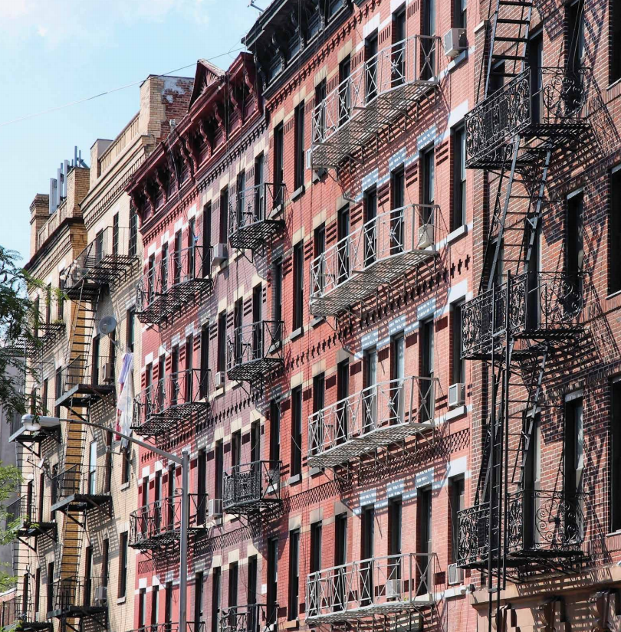
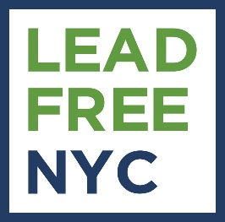
New York City’s Roadmap to Eliminating Childhood Lead Exposure
Kathryn Garcia
Senior Advisor
Citywide Lead Prevention
October 4, 2019

Slide 2
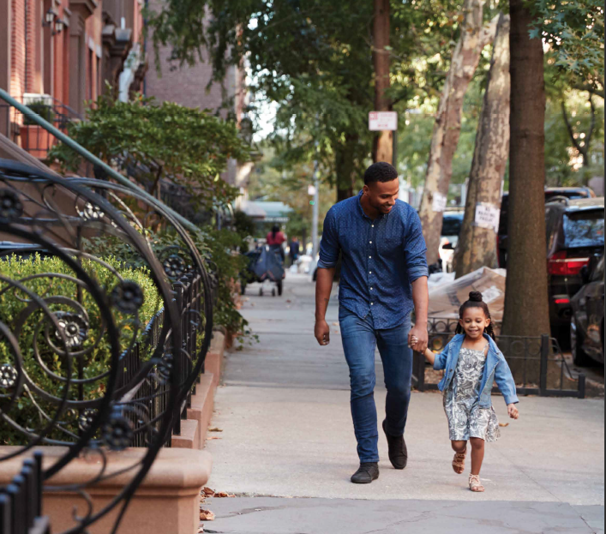
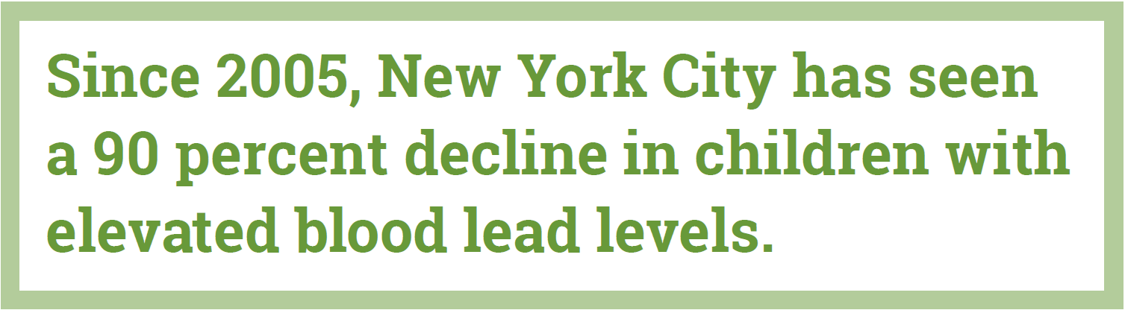
New York City is a leader in preventing childhood lead exposure
1960: NYC Board of Health prohibits use of lead paint in residential buildings
2004: Local Law 1
  Childhood Lead Poisoning Prevention Act
  Requires annual visual inspections of apartments with children and abatement of lead paint on apartment turnover
2018: Mayor de Blasio expands environmental investigations to all children with BLL of 5µg/dL and above.

Slide 3
LeadFreeNYC builds on our progress

Slide 4
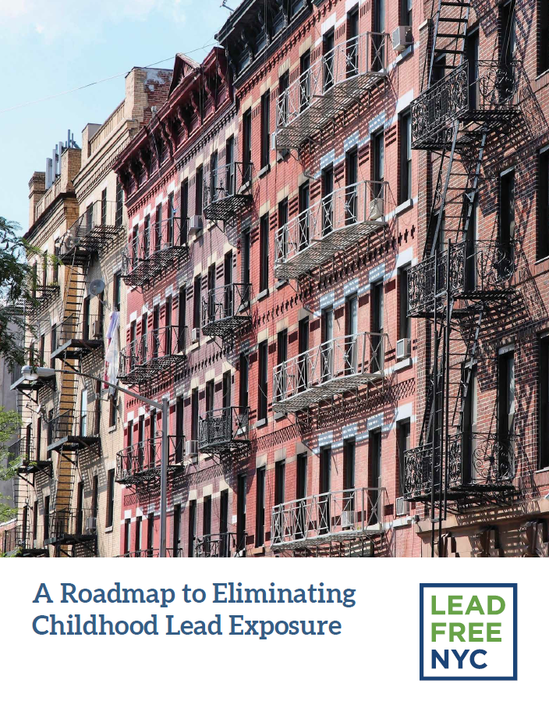
LeadFreeNYC builds on our progress
90-day review of all City policies, programs and agencies
Roadmap to virtually eliminate lead poisoning in NYC children
Focus on four key areas:
  Screening and supporting children
  Eliminating lead paint hazards
  Eliminating dangerous consumer products
  Managing other lead paint hazards
Builds accountability and management framework to ensure success
Download the report at: nyc.gov/leadfree

Slide 5
Protect our Kids:
Screen and Support our Children
New York City is one of the first jurisdictions in the country to conduct environmental investigations for children with a blood lead level of 5 micrograms per deciliter and above.

Slide 6
Protect our Kids:
Screen and Support our Children
Deepen support when kids are exposed to lead hazards
  Expand coordinated care to all kids with EBLLs
Increase the number of children screened for EBLLs
  Improve the Citywide Immunization Registry
  Expand outreach to parents
  Reach more communities through targeted campaigns
  Enhance coordination and resources for families during peeling paint complaints
  Offer free blood lead testing for children under 6 who lack access
  Continue to enforce blood lead testing requirement for child care admission
  Strengthen testing at City hospitals

Slide 7
Paint is the Problem:
Eliminate Lead Paint Hazards
Lead paint and the dust created by disturbing it are the most common causes of elevated blood lead levels in children.

Slide 8
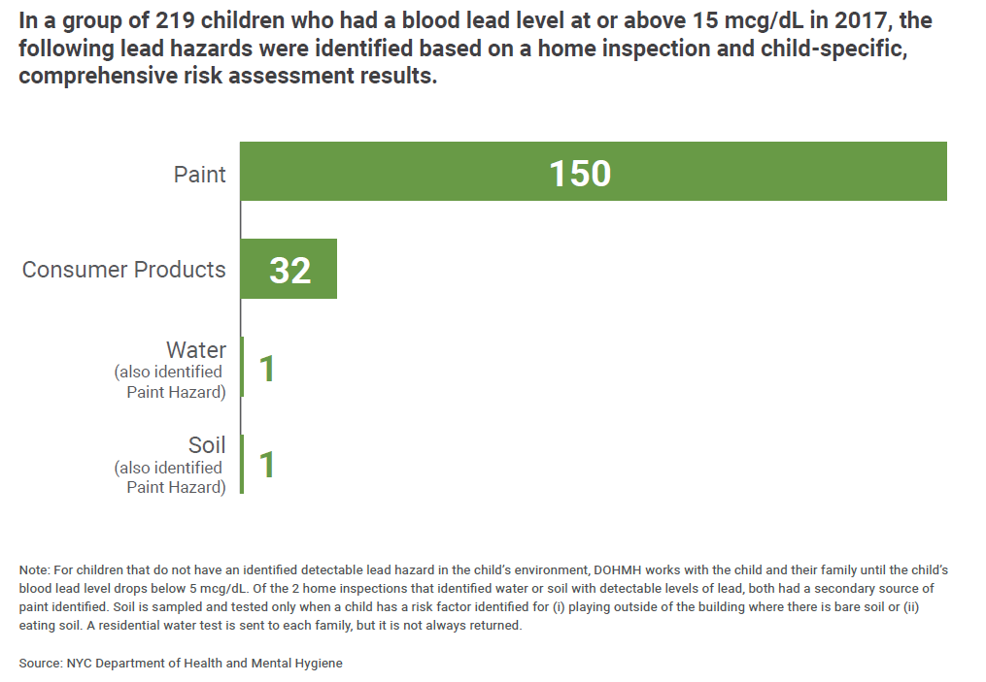
Paint is the Problem:
Eliminate Lead Paint Hazards

Slide 9
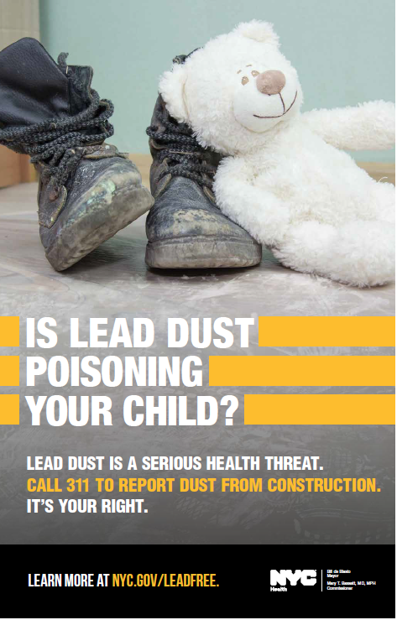
Paint is the Problem:
Eliminate Lead Paint Hazards
Expand the reach of LL1
  Lower lead paint definition from 1 µg/cm² to 0.5 µg/cm²
  Lower lead dust threshold to 10 µg/ft² for floors and 100 µg/cm² for windows
  Expand LL1 to include 1- and 2-family homes with kids under 6
Strengthen enforcement of LL1
  Create a “Building Lead Index” to better target proactive inspections
  Proactively audit lead-related records kept by landlords
  Aggressively increase oversight for work that poses a risk of lead dust

Slide 10
Paint is the Problem:
Eliminate Lead Paint Hazards
Help private landlords become lead-free
  Expand financial assistance for landlords who abate hazards while preserving affordability
  Expand landlord outreach and language services
  Require landlords to maintain lead-related records online
  Restructure exemption process to create a “Lead Paint Free” certification

Slide 11
Paint is the Problem:
Eliminate Lead Paint Hazards
Ensure lead paint hazards are addressed in public housing and City housing programs
  Test NYCHA units for lead hazards
  Ensure staff are trained on lead-safe work practices
  Make testing results and progress available to residents and public
In shelters: Invest $7m to test for and eliminate lead from all family shelter units
In other subsidized housing: Continue robust processes for subsidized housing programs

Slide 12
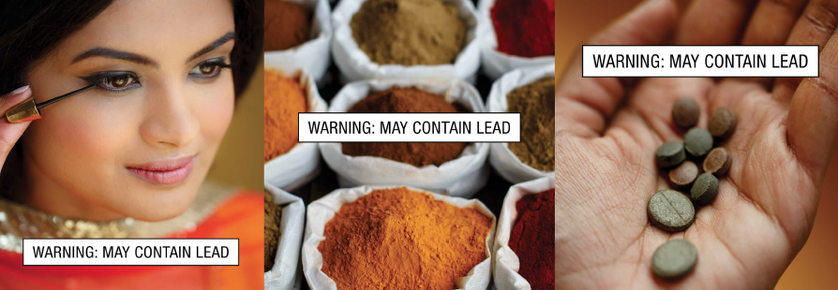
Eliminate Dangerous Consumer Products
Unsafe consumer products, including certain ceramics, jewelry, cosmetics, toys and spices sourced from other countries, are the second most common source of lead exposure in New York City.

Slide 13
Eliminate Dangerous Consumer Products
Create a “Lead Products Index” for unsafe products
Require mandatory “Safe Products Awareness” training for businesses that sell unsafe products
Require high penalties for businesses that willfully sell harmful products
Invest $750,000 annually to add inspection and testing resources
Target education and outreach about unsafe products to high-risk communities

Slide 14
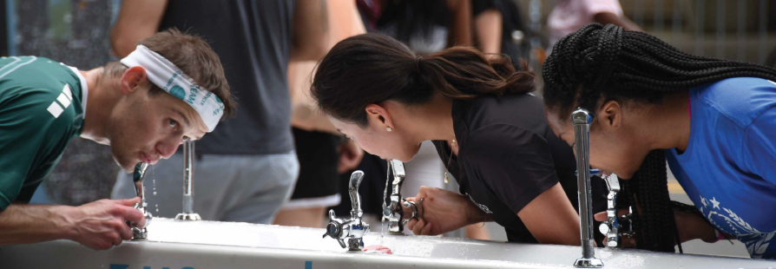
Manage Other Potential Hazards
Water and soil have not been shown to be significant causes of elevated blood lead levels in kids. However, the City will take steps to mitigate risk and reduce the hazards of lead exposure.

Slide 15
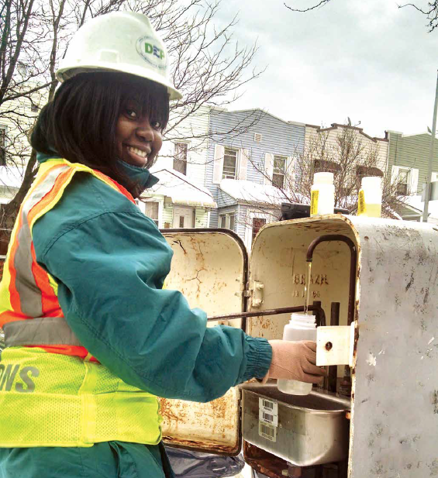
Manage Other Potential Hazards
Reduce risks associated with privately-owned lead plumbing
  Expand efforts to replace lead service lines
  Publish a map of all lead service lines
  Continue to survey and replace any City-owned water infrastructure containing lead
  Promote free water testing kits
  Actively participate in ongoing water research

Slide 16
Manage Other Potential Hazards
Before
Educate the public about lead in soil
  Educate the public about safe soil practices
  Provide clean soil to communities impacted by high levels of lead in soil
  Survey NYCHA playgrounds to identify and address bare soil risks
After
Clean Soil Bank Garden in Brooklyn

Slide 17
Kathryn Garcia
Senior Advisor
Citywide Lead Prevention
Contact: kgarcia@dsny.nyc.gov
Learn more: nyc.gov/leadfree

